Slide 1

Amazon Books Review ( Queries + EDA )
Presentation by
Gireesh Shankar

Slide 2
OUR DATA SETS : 1)Books_rating.csv (2.86 GB) 2)books_data.csv (181.35 MB)
Data sets are from
SOURCE:
https://www.kaggle.com/datasets/mohamedbakhet/amazon-books-reviews

Slide 3

Briefing about our data sets:
Books_rating :- This file has information about 3M book reviews for unique books and users who gives these reviews for each book.
Books_data :- This file contains the details of 212404 books such as genres, authors, cover, description and etc.
Total we have 20 fields file1 contains 10 columns and file 2 contains 10 columns they are listed below:->
(File1)Books_rating :- 'Id', 'Title', 'Price', 'User_id', 'profileName', 'review/helpfulness','review/score', 'review/time', 'review/summary', 'review/text'
(File2)books_data :-
'Title', 'description', 'authors', 'image', 'previewLink', 'publisher', 'publishedDate', 'infoLink', 'categories', 'ratingsCount’
We have used Google colab as our platform in order to run total EDA.

Slide 4
The Big Data Environment Used for the Project:
The primary tools used in this project are:
Our project utilizes Google Colab.
It is a cloud-based platform that allows users to write and execute code in Python. Google Colab is chosen for its collaborative features, ease of use, and integration with Google Drive for file storage
Python: The programming language used for data manipulation and analysis.
Pandas: For data cleaning and manipulation in DataFrames.
PySpark: To leverage distributed computing for handling larger datasets.
Matplotlib and Seaborn: For data visualization and plotting.
And
Reasons for Using These Tools:-→
Python: Offers a broad range of libraries for data science, making it ideal for handling datasets and performing data analysis.
Pandas: Provides a convenient way to manipulate data and merge datasets.
PySpark: Useful for processing large datasets efficiently in a distributed environment.
Matplotlib and Seaborn: Essential for creating visualizations and exploratory data analysis.

Slide 5


Data sets loading and merging :
Libraries and Creating Spark session
Loading the DATA sets in to Google Colab
Importing Libraries: We start by importing necessary Python libraries:
Pandas: for data manipulation and analysis.
PySpark: for distributed data processing.
matplotlib and seaborn: for data visualization.
Initializing SparkSession: We create a SparkSession, the entry point to programming with Spark.
Merging Datasets: We merge two datasets based on a common column, 'Title'. This combines data from different sources into a single dataset.
Displaying Merged Dataset: We print the first few rows of the merged dataset to visually inspect the data and ensure the merge was successful.
Printing Column Names: Finally, we print the names of the columns in the merged dataset to understand the available data fields.
Loading Datasets: We load two datasets, namely 'Books_rating.csv' and 'books_data.csv', into pandas DataFrames. These datasets contain information about book ratings and book details, respectively.
Printing Column Names: We print the names of the columns in each dataset to understand the available data fields.
Printing Dataset Shapes: We print the shapes of both datasets to understand the size of each dataset, i.e., the number of rows and columns.
Output:
Shape of 'rating' dataset: (3000000, 10)
Shape of 'data' dataset: (212404, 10)
And

Slide 6

Useful columns:
Title
review/score
review/text
Authors
categories
ratingsCount
Price
publisher
Extracting Useful Columns:
We extract specific columns from the merged dataset that are relevant for our analysis. These columns include 'Title', 'review/score', 'review/text', 'authors', 'categories', 'ratingsCount', 'Price', and 'publisher'.
Cleaning Texts:
We perform text cleaning on the 'authors' and 'categories' columns to remove unnecessary characters like brackets and colons. This step improves the readability and consistency of the data.
Handling Missing Values:
We handle missing values in the 'review/text' column by replacing them with empty strings. This ensures that we can perform analysis on the textual data without encountering errors due to missing values.
Counting Words in Reviews:
We count the number of words in each review by splitting the text on spaces and counting the resulting list's length. This allows us to analyze the length of reviews and their impact on various factors.

Slide 7
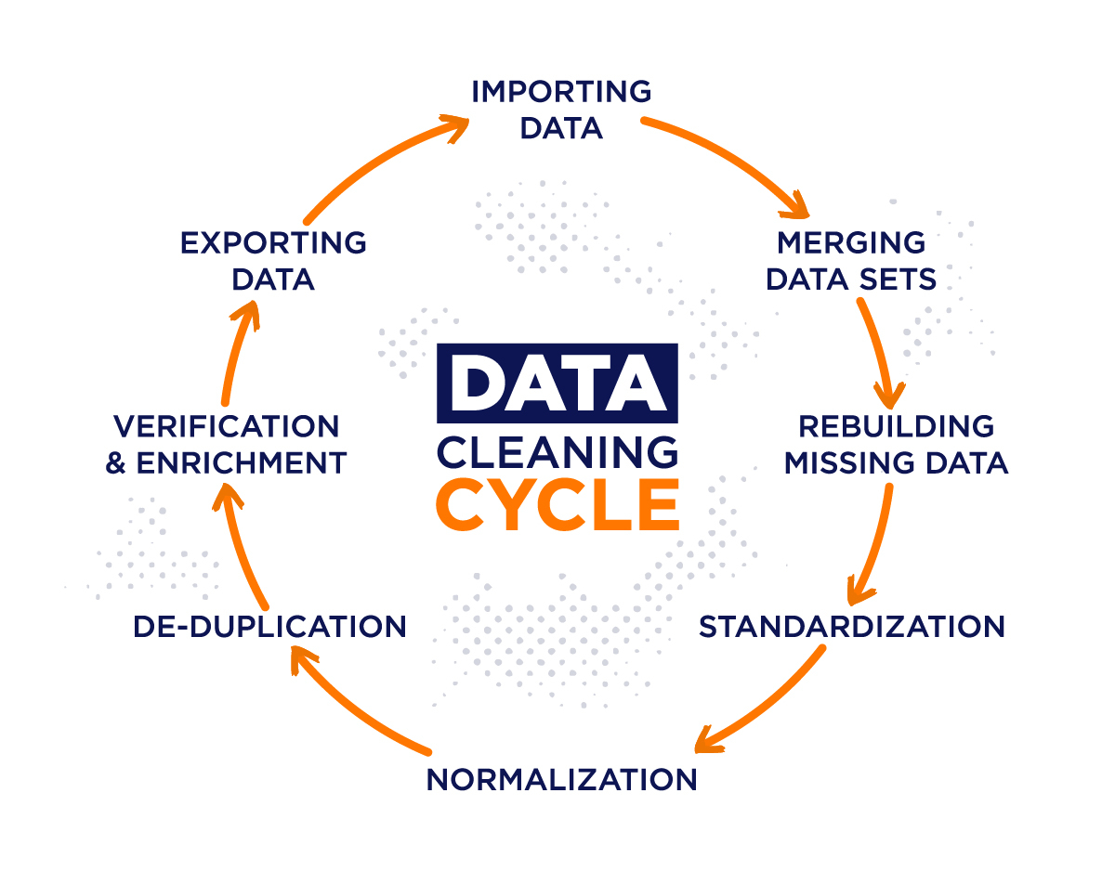
DATA CLEANING:
Identify Missing Values:
We start by identifying missing values in the dataset using the isnull() function, which returns a DataFrame with Boolean values indicating whether each cell is null or not.
By summing up the boolean values for each column using sum(), we can count the number of missing values in each column.
Handle Missing Values:
To handle missing values, we choose a simple approach: dropping rows with any missing values. This simplifies the data cleaning process.
Identify Duplicate Rows:
We check for duplicate rows in the cleaned dataset using the duplicated() function, which returns boolean Series denoting duplicate rows.
Drop Duplicate Rows:
After identifying duplicate rows, we drop them from the cleaned dataset using the drop_duplicates() function.
Summary:
We provide a summary of the cleaning process, including the number of rows before and after cleaning, and the first five rows of the dataset before and after cleanup.
Summary after cleaning:
Number of rows before cleaning: 3000000 ; Number of rows after cleaning: 211733
Convert to PySpark DataFrame and Save:
Finally, we convert the cleaned pandas DataFrame to a PySpark DataFrame using spark.createDataFrame().
We then save the cleaned DataFrame to a CSV file in Google Drive for further analysis.
DATA CLEANING

Slide 8
Queries
Queries | Execution | Output
# Query 1: List the top 10 most reviewed books query1 = """ SELECT Title, COUNT(*) AS review_count FROM data_cleaned GROUP BY Title ORDER BY review_count DESC LIMIT 10 """ result1 = spark.sql(query1) result1.show() | - Purpose: This query aims to identify the ten books with the highest number of reviews. - Execution: The dataset is grouped by book titles, and the number of occurrences of each title is counted. The results are then sorted in descending order based on the count of reviews and limited to the top 10. | - For example, the book "Hannibal" has the highest number of reviews with 2775 reviews, indicating it is highly discussed or read by users.
# Query 2: Find the average review score of books by each author query2 = """ SELECT authors, AVG(`review/score`) AS avg_review_score FROM data_cleaned GROUP BY authors """ result2 = spark.sql(query2) result2.show() | - Purpose: This query calculates the average review score for books authored by each writer. - Execution: The dataset is grouped by authors, and the average review score for each author's books is computed. | - For instance, books by "Alan Garner" have an average review score of 4.54, indicating that they are generally well-received by readers.
# Query 3: Identify the categories with the highest average ratings query3 = """ SELECT categories, AVG(`review/score`) AS avg_rating FROM data_cleaned GROUP BY categories ORDER BY avg_rating DESC LIMIT 5 """ result3 = spark.sql(query3) result3.show() | - Purpose: This query identifies the categories (genres or subjects) that receive the highest average review ratings. - Execution: The dataset is grouped by categories, and the average review score for each category is calculated. The results are sorted in descending order based on the average rating and limited to the top 5. | - For example, books categorized under "China" have the highest average rating of 5.0, suggesting that they are highly appreciated by readers.
# Moderately Complex Queries # Query 4: Calculate the average word count of reviews for each category query4 = """ SELECT categories, AVG(word_count) AS avg_word_count FROM data_cleaned GROUP BY categories ORDER BY avg_word_count DESC """ result4 = spark.sql(query4) result4.show() | - Purpose: This query calculates the average word count of reviews for books in each category. - Execution: The dataset is grouped by categories, and the average word count of reviews for each category is computed. | - For instance, books categorized under "Apologetics" have an average word count of 1448.5, indicating that reviews in this category tend to be more detailed or extensive.

Slide 9
Queries
Queries | Execution | Output
# Query 5: Determine the total number of ratings for each book query5 = """ SELECT Title, SUM(ratingsCount) AS total_ratings FROM data_cleaned GROUP BY Title ORDER BY total_ratings DESC """ result5 = spark.sql(query5) result5.show() | - Purpose: This query determines the total number of ratings received by each book, indicating their popularity. - Execution: The dataset is grouped by book titles, and the sum of ratings count for each title is calculated. The results are sorted in descending order based on the total ratings count. | - For example, "Jane Eyre (New Wi..." has the highest total ratings count of 3,882,516, indicating it is widely read and rated by users.
# Query 6: Find the authors with the highest number of books query6 = """ SELECT authors, COUNT(*) AS book_count FROM data_cleaned GROUP BY authors ORDER BY book_count DESC LIMIT 5 """ result6 = spark.sql(query6) result6.show() | - Purpose: This query identifies the authors who have written the most books in the dataset. - Execution: The dataset is grouped by authors, and the count of books authored by each writer is computed. The results are sorted in descending order based on the count of books. | - For example, "Thomas Harris" has the highest number of books with 2776 titles attributed to them, indicating they have a significant presence in the dataset.
# Complex Queries # Query 7: Perform sentiment analysis on review text to categorize reviews as positive, neutral, or negative query7 = """ SELECT Title, CASE WHEN LOWER(`review/text`) LIKE '%good%' OR LOWER(`review/text`) LIKE '%excellent%' THEN 'Positive' WHEN LOWER(`review/text`) LIKE '%bad%' OR LOWER(`review/text`) LIKE '%poor%' THEN 'Negative' ELSE 'Neutral' END AS sentiment FROM data_cleaned """ result7 = spark.sql(query7) result7.show() | - Purpose: This query performs sentiment analysis on review text to categorize reviews as positive, neutral, or negative based on specific keywords present in the text. - Execution: The review text is analyzed, and each review is categorized as positive, neutral, or negative based on the presence of certain keywords such as "good," "excellent," "bad," or "poor." | - For instance, the sentiment analysis categorizes reviews for the book "Toujours Provence" as mostly neutral, with a few categorized as positive.
# Query 8: Build a recommendation system to suggest similar books based on categories and ratings query8 = """ SELECT a.Title AS book_title, b.Title AS recommended_book FROM data_cleaned a JOIN ( SELECT Title, categories FROM data_cleaned GROUP BY Title, categories ) b ON a.categories = b.categories AND a.Title != b.Title """ result8 = spark.sql(query8) result8.show() | - Purpose: This query builds a recommendation system to suggest similar books based on shared categories and comparable ratings. - Execution: The dataset is joined with itself based on shared categories, excluding the same book, to recommend similar books within each category. | - For example, the book "Daring" is recommended alongside other titles based on similar categories and ratings criteria.

Slide 10
Queries
Queries | Execution | Output
# Query 9: Calculate the average rating score and word count of reviews for each author query9 = """ SELECT authors, AVG(`review/score`) AS avg_review_score, AVG(word_count) AS avg_word_count FROM data_cleaned GROUP BY authors """ result9 = spark.sql(query9) result9.show() | - Purpose: This query calculates the average review score and the average word count of reviews for books authored by each writer. - Execution: The dataset is grouped by authors, and the average review score and word count of reviews for each author's books are computed. | - For example, books authored by "Lisa Genova" have an average review score of 3.5 and an average word count of 211.63.
# Query 10: Analyze the relationship between publisher's average review score, total ratings count, and book price query10 = """ SELECT m.Title, m.Price, m.publisher, p.avg_review_score, p.total_ratings_count FROM data_cleaned m JOIN ( SELECT publisher, AVG(`review/score`) AS avg_review_score, SUM(ratingsCount) AS total_ratings_count FROM data_cleaned GROUP BY publisher ) p ON m.publisher = p.publisher ORDER BY m.Price DESC """ result10 = spark.sql(query10) result10.show() | - Purpose: This query analyzes the relationship between a book's publisher, average review score, total ratings count, and price. - Execution: The dataset is joined with aggregated publisher data to relate average review scores, total ratings counts, and book prices for each publisher. | - For instance, books published by "Baker Books" have an average review score of 4.22 and a total ratings count of 5009, with prices ranging up to 665.56.

Slide 11
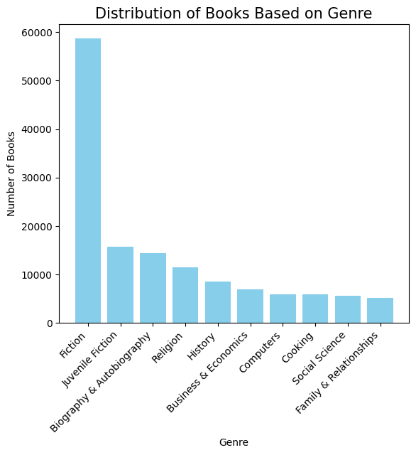
This bar graph illustrates the distribution of books across different genres, such as Fiction, Biography & Autobiography, Religion, etc. - Example: The bar graph displays the number of books in the top 10 genres, with Fiction having the highest count. - For example, the bar graph shows that the genre "Fiction" has the highest count of books, with a total of more than 50000 books. This indicates that Fiction is the most prevalent genre among the dataset.
**Distribution of Books Based on Genre (Bar Graph)**:

Slide 12
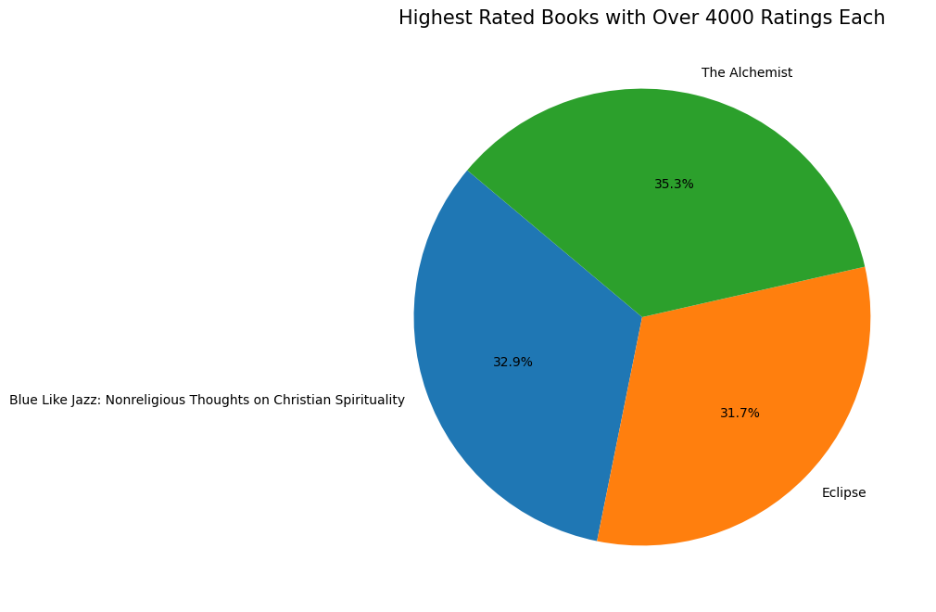
- This pie chart visualizes the proportion of highly rated books, each with over 4000 ratings. - Example: The pie chart segments represent different highly rated books, with each segment showing its proportion relative to the total. - In the pie chart, one segment represents a highly rated book. For instance, the book “The Alchemist" occupies 35.3% of the chart, signifying that it is one of the highly rated books with over 4000 ratings out of the total.
**Highest Rated Books with Over 4000 Ratings Each (Pie Chart)**:

Slide 13

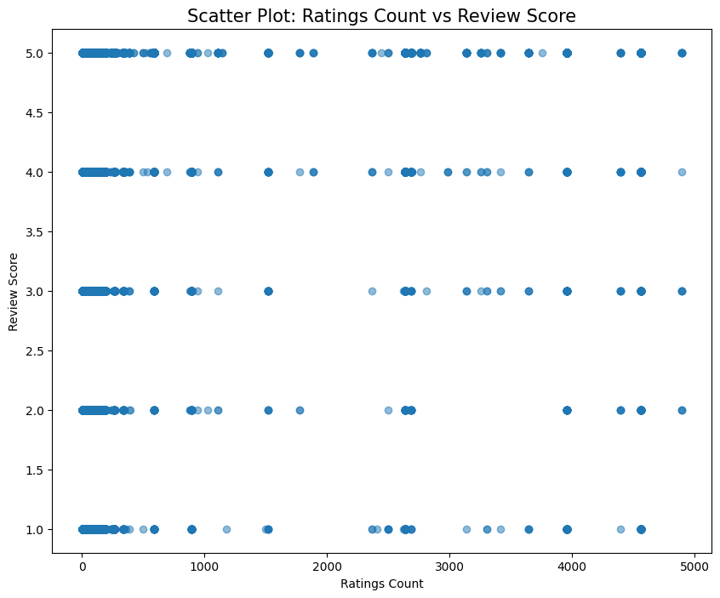
**Scatter Plot: Ratings Count vs Review Score**:
- This scatter plot showcases the relationship between the number of ratings a book receives and its review score.
- Example: Each point on the scatter plot represents a book, with its position indicating both the number of ratings it has received and its average review score.
Let's say a point on the scatter plot represents a book with 5000 ratings and a review score of 5.0. This point indicates that the book received a high number of ratings and a relatively positive review score.

Slide 14
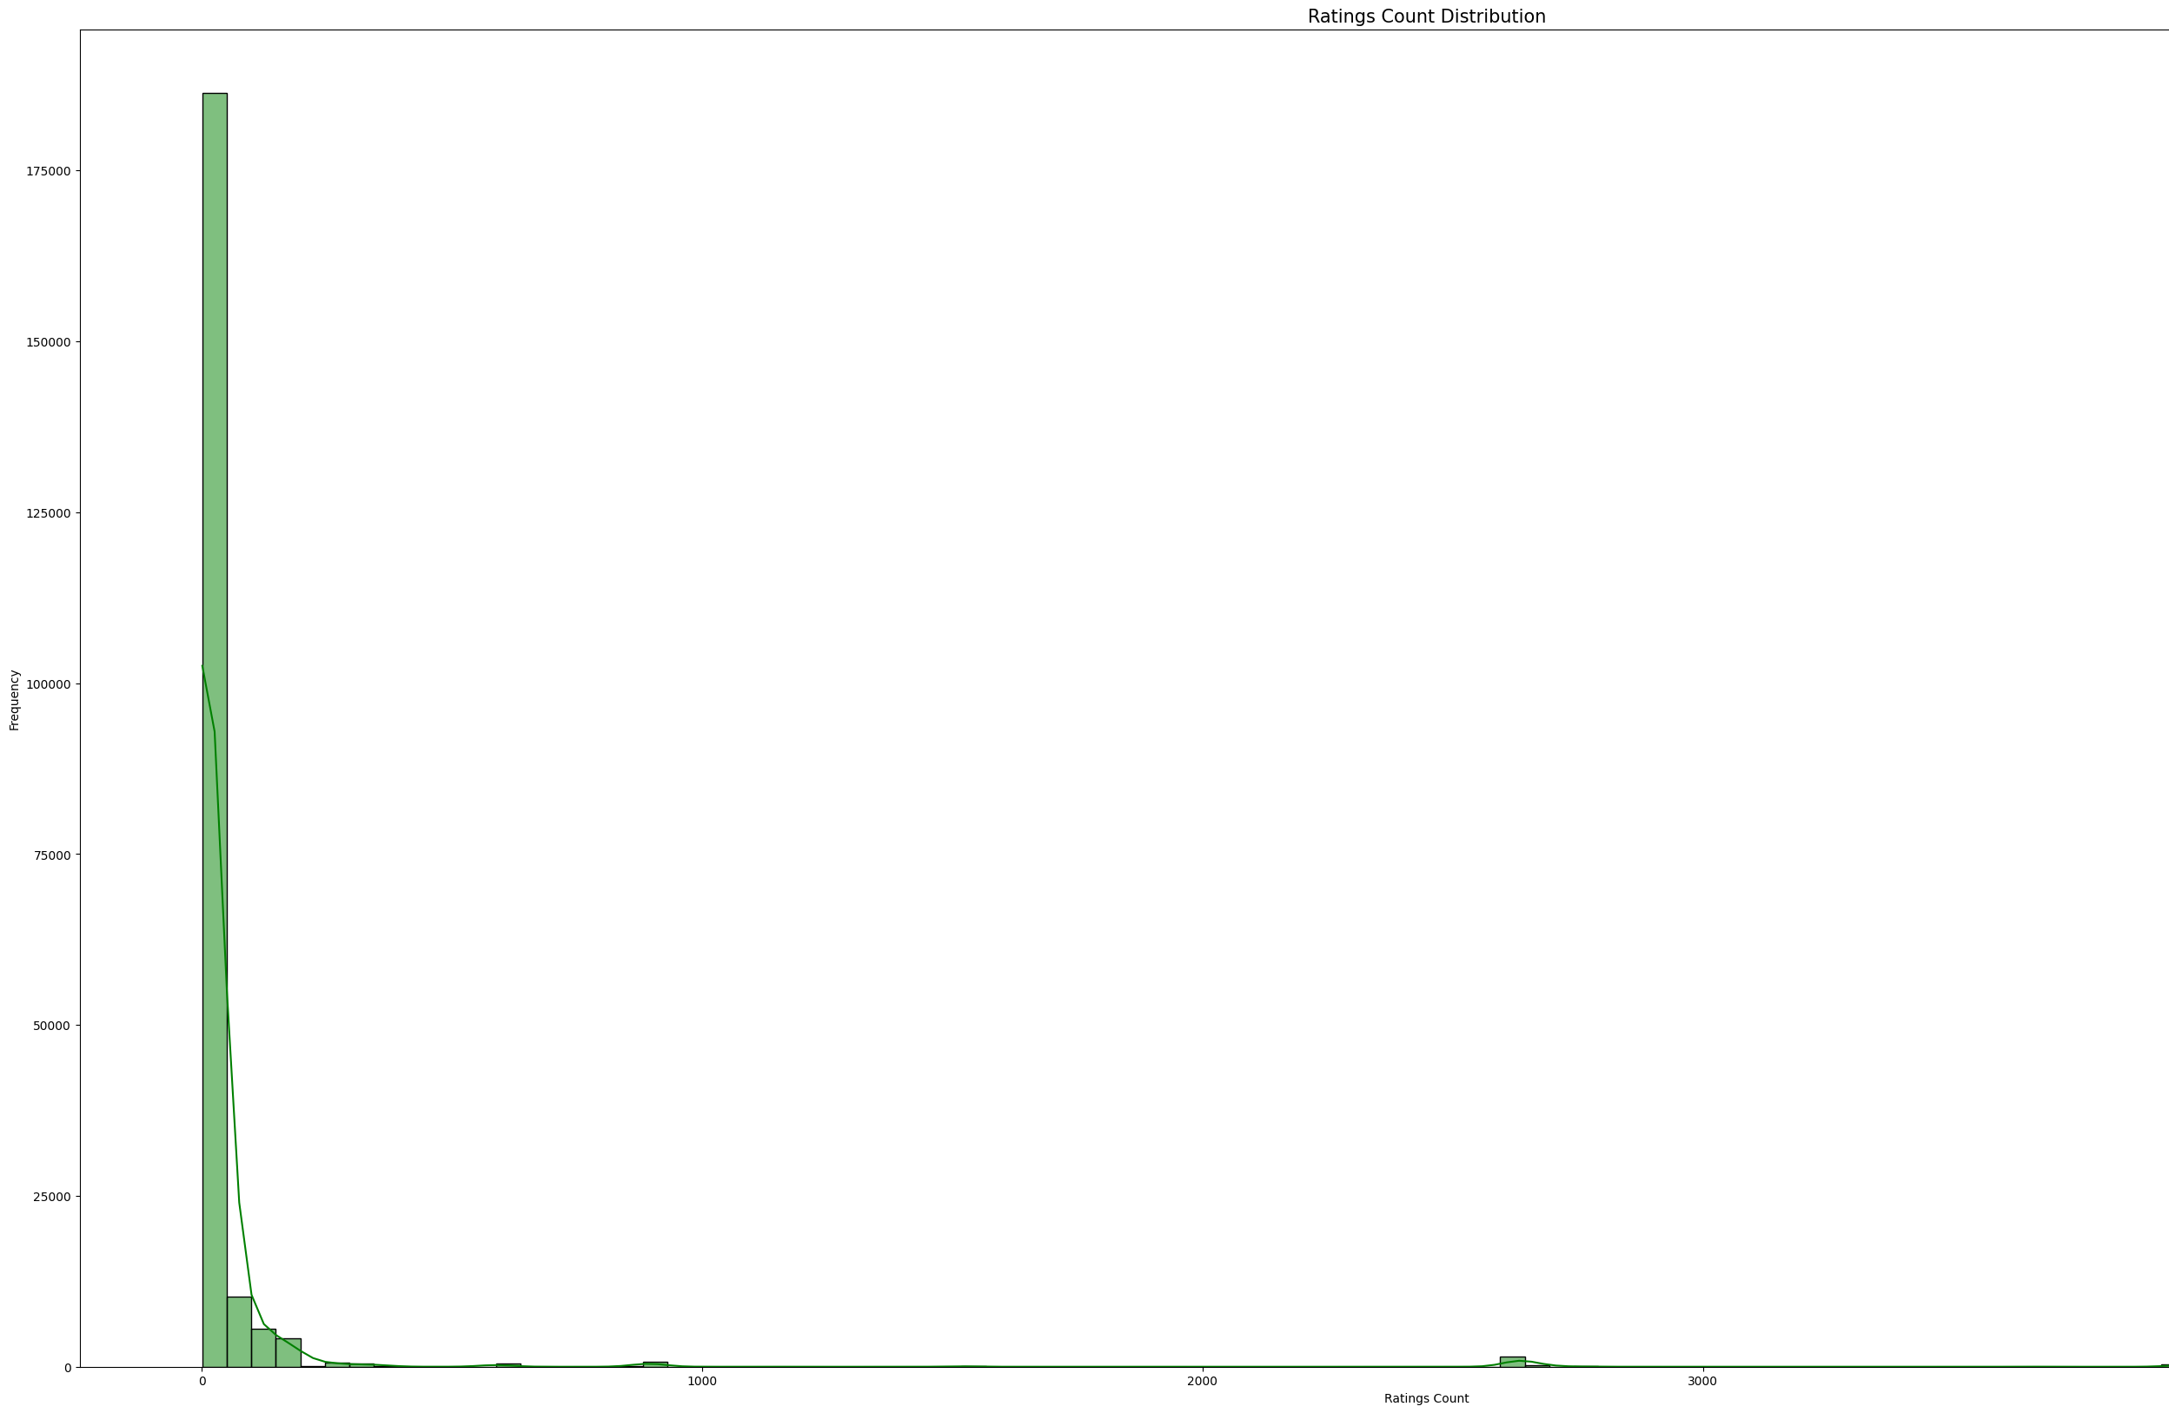
**Ratings Count Distribution (Histogram)**:
- This histogram displays the distribution of ratings counts across all books.
- Example: The histogram depicts the frequency of books based on the number of ratings they have received, providing insights into the distribution pattern.
- Suppose the histogram shows that the majority of books have received ratings counts between 1 and 1000. This suggests that most books in the dataset have garnered moderate to high levels of user engagement.
X-axis is frequency
Y-axis is ratings count

Slide 15
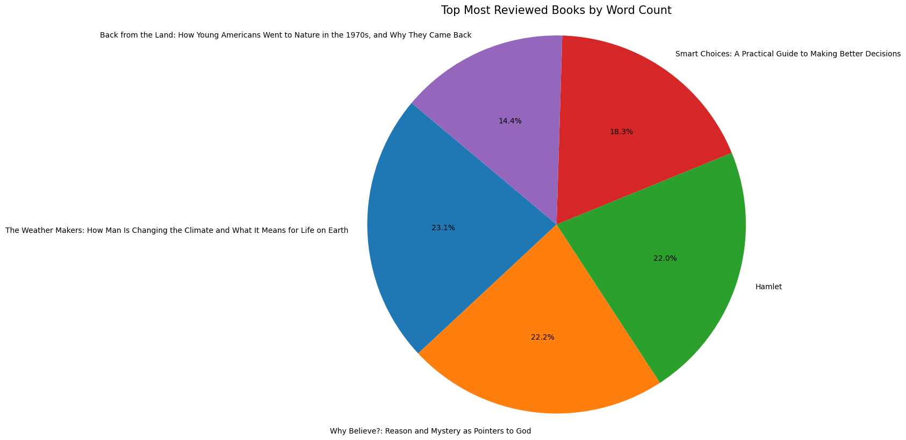
**Topmost Reviewed Books by Word Count (Pie Chart)**:
- This pie chart highlights the topmost reviewed books based on their word count.
- Example: Each segment of the pie chart represents a book, with the size of the segment corresponding to the word count of the book.
- For example, if The” weather makers: how man is changing …”occupies the largest segment in the pie chart, it implies that this book has the highest word count among the topmost reviewed books. The size of the segment indicates the magnitude of its word count relative to others.

Slide 16
Conclusion and analysis:
The combined insights from EDA and SQL queries provide a comprehensive understanding of the dataset.
Fiction remains the dominant genre, while highly rated books like "The Alchemist" enjoy enduring popularity.
The positive correlation between ratings count and review score suggests that well-reviewed books tend to attract more ratings.
Authors' reception varies, as seen from the average review scores, and certain categories receive higher average ratings than others.
Detailed feedback or discussions are evident for books with higher word counts in reviews, reflecting readers' engagement.
The total number of ratings indicates the popularity of certain books, influencing their overall reception and standing within the dataset.

Slide 17
References:
McKinney, W. (2017). Python for Data Analysis: Data Wrangling with Pandas, NumPy, and IPython (2nd ed.). O'Reilly Media.
Wickham, H., & Grolemund, G. (2017): Import, Tidy, Transform, Visualize, and Model Data. O'Reilly Media.
VanderPlas, J. (2016). Python Data Science Handbook: Essential Tools for Working with Data. O'Reilly Media.

Slide 18
Thank You
“Data is like garbage. You’d better know what you are going to do with it before you collect it.”
~ Mark Twain
Uma shankar Ganta
Gireesh

